Slide 1
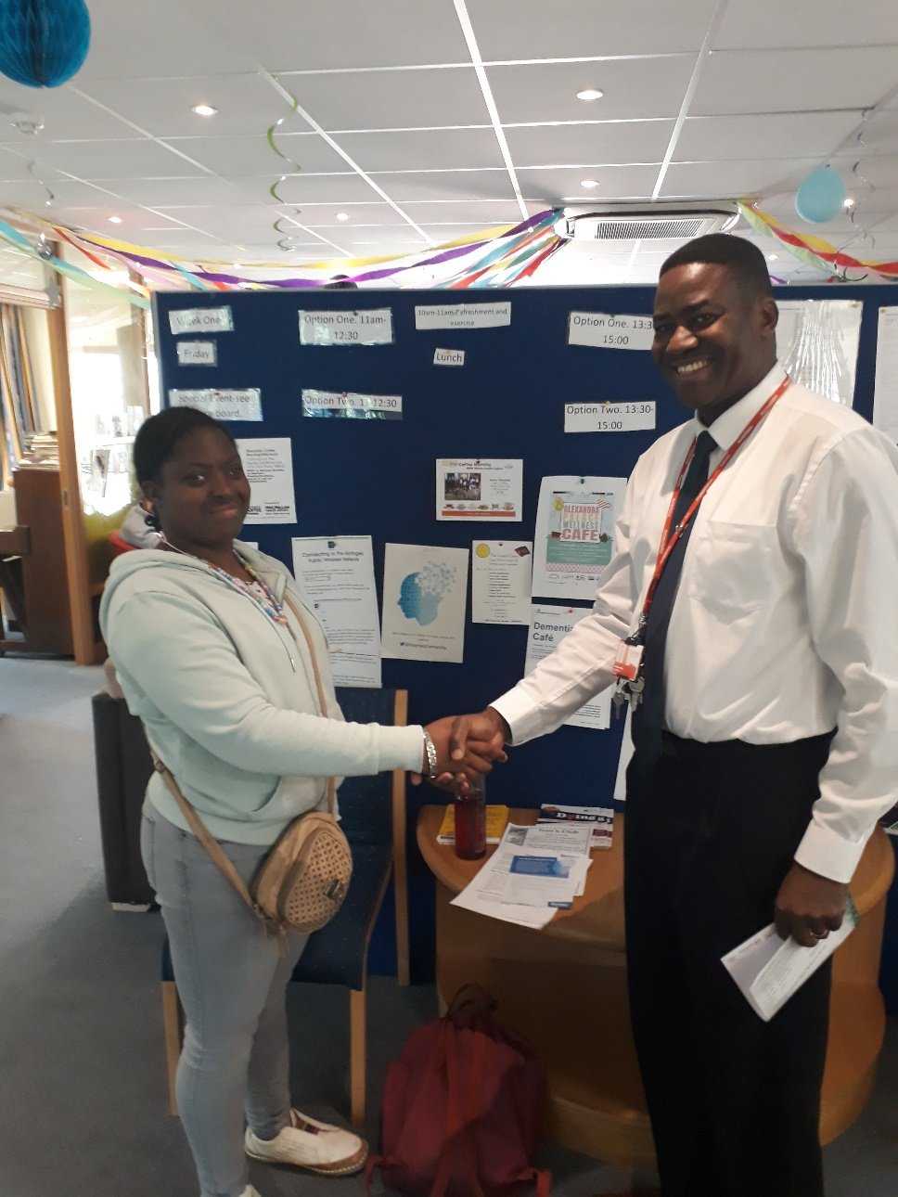
Preparing for adulthood
I’m on a work placement at Haynes Dementia Centre
October 2019

Slide 2





Achievements
Transition Policy drafted to make clear the Councils policy on moving on to adult life, consultation in November
11 young people have received job coaching support and are in placements such as Bikes for Causes, learning work skills as part of Haringey Employment Support Project
12 Supported Internships started in September at North Middlesex Hospital, includes 2 Haringey young people
Delivered British Association Supported Employment training to staff to enhance post 16 conversations with young people
Secured free mental health support for people aged 16+ to access the Haringey Wellbeing Network
Notes:
Outstanding:
Good quality activity and cost data is available to enable transition projections for strategic planning and commissioning;
Internships programme agreed with provider to support people with disabilities into employment.
Haringey Wellbeing Network – newly commissioned

Slide 3





Achievements
Staff and partners have received presentations to enhance knowledge and signposting to community services
IT system updated to improve referral times for Transitioning from children’s services to adult services
Working with mental health partners to manage internal transition cases more effectively
Agreed process with Health colleagues to ensure a seamless transition for young people with complex health needs.
Involved Moving on co-production group with families to develop Transition Pathway Guide for families

Slide 4






Moving On Transitions Reference Group
Co-production achievements
Apps for social care web page developed for service users to promote independence
“Moving on Tool” developed for young people to find disability wellbeing information more easily
Enhanced information and signposting on SEND Local Offer web page: Post 16 choices, Colleges, Employment, Transitions, News
Enhanced information and signposting on Adult social care web pages on Housing, Preparing for adulthood
Developed surveys to improve SEND information
Developed and published a Transitions Pathway Guide in 2019
Notes:
Outstanding:
Good quality activity and cost data is available to enable transition projections for strategic planning and commissioning;
Internships programme agreed with provider to support people with disabilities into employment.
Haringey Wellbeing Network – newly commissioned

Slide 5
Listening to you
You said | Our response
Give advance notice of future events taking place to reach a wider audience | We will include information on the SEND Local Offer news, SEND newsletter and use the Parent forums and school newsletters to circulate information above events.
Make presentations more accessible, use infographics | We aim to make presentations easier to read.
Have a forum for parents | More coffee meet ups for SEND families have been developed across the borough
To have more opportunities to discuss issues with professionals | SEND Information and Advice Services will have weekly sessions at Marcus Garvey library and Wood Green library, where other Council staff will be present as part of our early intervention offer.
Have more provision for disabled people | We are in partnership with North Middlesex Hospital Project Search which offers 12 Supported Internships for young people . Council is working with Moving On Group to develop Day Opportunities Autism Hub in Tottenham.

Slide 6
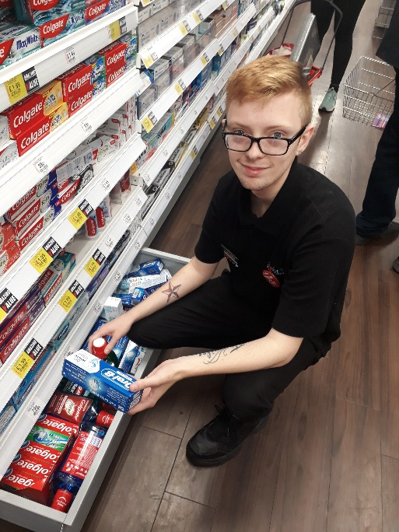
Next steps
Staff are using the Preparing for Adulthood Pathway Guide to signpost and support people appropriately
We have began our project with “my AFK (formerly Action for kids)” to support 27 young people with learning needs into employment placements
Staff and partners are working together to develop employment
opportunities for Haringey people with learning disabilities and
roles within the Council
We are working with colleges, employers and organisations to
increase Supported Internships
I’m on a work placement at Savers
We are working with colleges to identify and increase the range of courses available to meet demand
The Council is working with residents and partners to develop a day opportunities hub so that people with disabilities and autism are supported to develop independence skills.

Slide 7


Independence Pathway trial:
2 Preparing for Adulthood Officers recruited to support young people to identify positive outcomes
Working with young people aged 16 and families before they transition, to support to maximise independence and use community services, to work with schools.
Working with young people after they Transition aged 18-24, to support and signpost to employment, Supported Internships and community services.

Slide 8
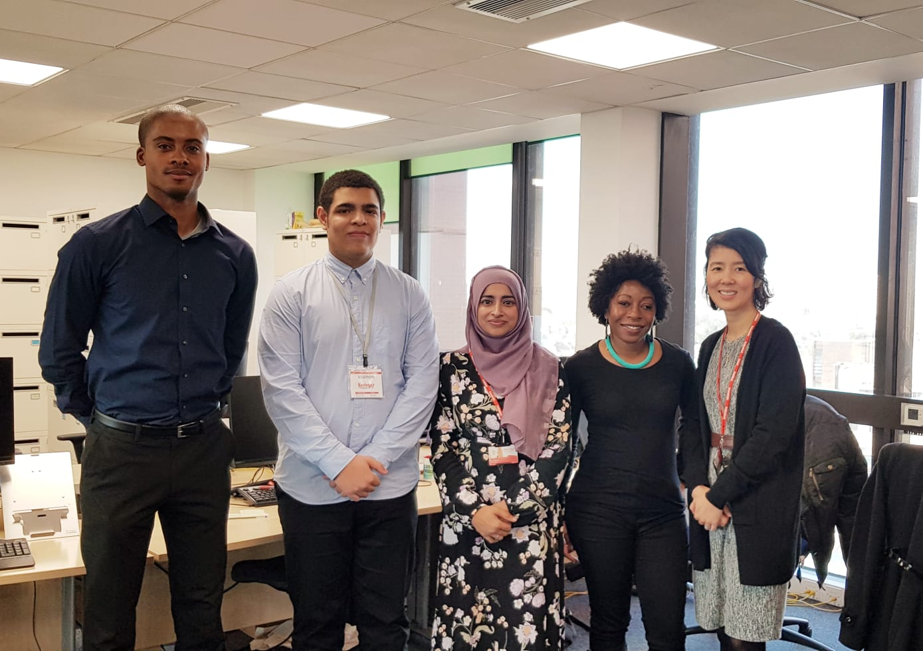
Work experience
I learnt new skills using the computer to create labels using Mail merge and did research using the Internet
He told us about a gaming convention that he attended and gave us an insight into the life of younger people.
The team knew Javier has Autism, we worked together to give clear instructions and used a timetable
Javier was really punctual and easy to work with
October 2019

Slide 9
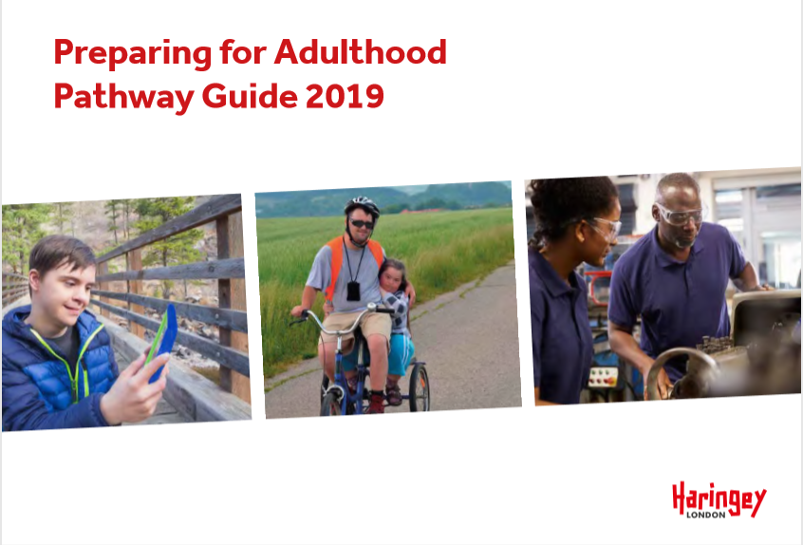
For more information:

Slide 10
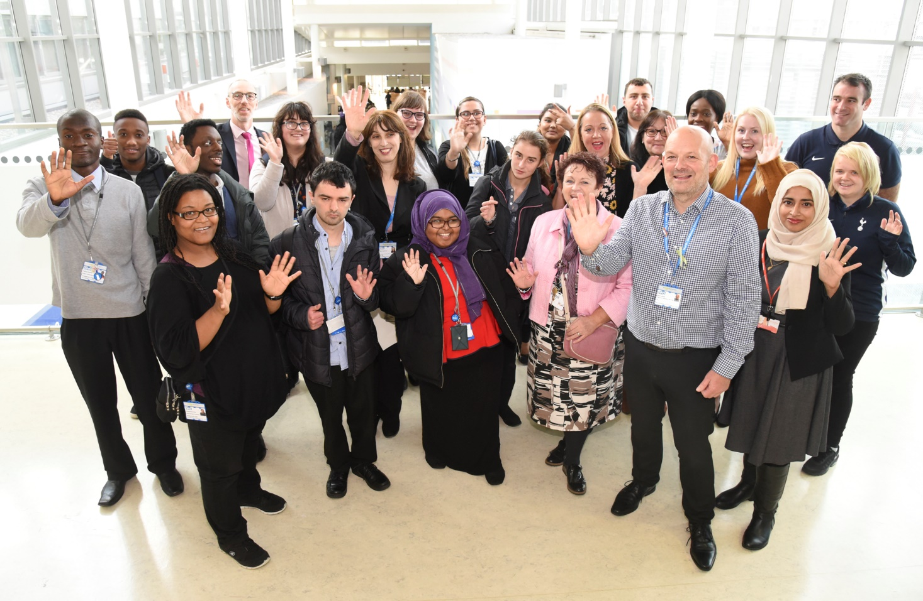
Questions:
?
Staff and trainees at North Middlesex Hospital Project Search Supported Internship programme

